Slide 1


Final Year Project
Carpool
Supervised By: Mr. Tajamul Shahzad (Junior Lecturer)

Slide 2
Project Team
Syed Mohid Ul Hassan (21131)
Sheraz Ahmad (20491)
Raja Kokub Mehboob (19685)

Slide 3
Table of Content
Opportunity & Stakeholders
Solution
Progress Report Summary
Requirements
Software System (Design + Implementation + Testing)
Endeavour (Team + Work + Way of Working)
Next Steps
Prototype / Report

Slide 4
Opportunity & Stakeholders

Slide 5
Opportunity & Stakeholders
In daily life a large number of people travel through local transport, private(personal vehicle) and special transport(booking a car)
People face many difficulties in local transport.
They either use their own vehicles, or book a vehicle for travelling.
Those people who have their own vehicles. It is very costly for them to use their vehicles.
Nowadays car owners are looking for sharing the empty seats and reducing their travelling cost.
People who use local transport are looking to save time.
Booking a car is very costly for people. They want to save money.

Slide 6
Opportunity & Stakeholders
Travelers (Passengers)
Drivers (Car Owners)
Admin

Slide 7
Solution
Carpool is a mobile application that allows users to schedule rides, search for available rides, and join other riders heading in the same direction to share transportation and enjoy the benefits together.
Carpool is a mobile application that allows users additional benefits which includes payment pathways, driver authentication, rating and review functionality, and cancellation of rides.

Slide 8
PROGRESS REPORT Summary

Slide 9
Requirements
Elicitation Techniques / Tools
Market Survey
Brainstorming
Interviews
Observation

Slide 10
Requirements
List of Different Users
Traveler (Passenger)
Drivers (Car Owners)
Admin
Use Cases : 29

Slide 11
Requirements
Functional Requirements:
We identified total 44 requirements.
Driver(20 FR)
Passenger (13 FR)
Admin(11 FR)

Slide 12
Design
Detailed Design
Use Case Diagrams
Activity Diagrams
Sequence Diagrams
Class Diagram
Architecture Diagram
Deployment Diagram

Slide 13
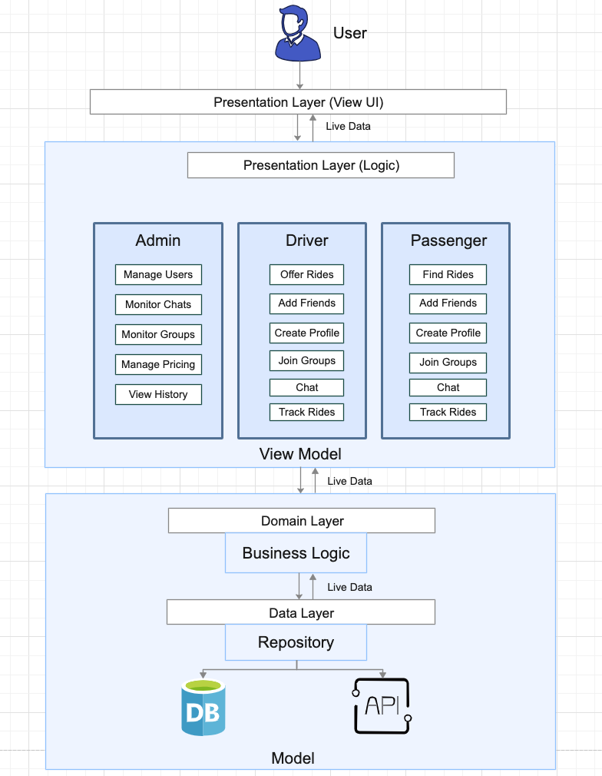
MVVM Architecture

Slide 14
Architecture
MVVM Architecture is a design approach that helps in building apps more effectively. It offers several benefits for our carpool app compared to other approaches:
Easy Organization: MVVM divides the code into three main parts: Model, View, and ViewModel. This separation helps keep things organized and makes it easier to understand and work with the different parts of your app.
Testing Made Simple: With MVVM, testing becomes easier. You can test the logic of your app without worrying too much about the actual look and feel. This means fewer bugs and more confidence that your app works as expected.
Smooth User Experience: MVVM handles changes in your device's settings, like when you rotate your phone, without disrupting the user experience. This ensures that your app continues to work well, no matter how you hold your phone.
Easy Updates: MVVM uses a technique called data binding, which simplifies updating your app's user interface. When the data changes, the interface automatically updates, reducing the amount of code you need to write.
Overall, MVVM architecture is a great choice for our carpool app because it helps keep your code organized, makes testing easier, provides a smooth user experience, and simplifies updates to your app's interface.

Slide 15
Implementation
List Development Tools & Technologies
VS Code
MS Visio
GitHub
MS Word
Android Studio

Slide 16
Technologies
Flutter
Dart
Firebase
JS
HTML
CSS

Slide 17
Implementation
List Libraries / Components / Web Services
React
Express
Firebase
Dart Packages
Bootstrap

Slide 18
Implementation
List Best Practices / Coding Standards
Provider (State Management in the Flutter)

Slide 19
Testing
Black Box Testing
Test Case Data.
Test Case Design.
Technique ECP ( Equivalence Class Partitioning )

Slide 20
Endeavour

Slide 21
Endeavour
Describe roles of your team members
Team Member | Roles
Syed Mohid Ul Hassan | Introduction
Syed Mohid Ul Hassan Sheraz Ahmad | Literature/Market Survey
Syed Mohid Ul Hassan Sheraz Ahmad Raja Kokub Mehboob | Requirement Analysis
Syed Mohid Ul Hassan Sheraz Ahmad Raja Kokub Mehboob | System Design
Syed Mohid Ul Hassan | Implementation Front End
Raja Kokub Mehboob | Testing & Evaluation

Slide 22
Endeavour
Describe your software development process
We have chosen the Kanban approach for our carpool app because it helps us handle changes smoothly and keep work moving forward without interruptions. With Kanban, we can easily see and prioritize tasks. Compared to other approaches like following a strict plan or fixed timelines, Kanban's flexibility makes it a better fit for our app as we adapt to evolving needs and strive for seamless development."

Slide 23
Endeavor
Describe your way of working as a team
Zoom and MS Teams Meetings.
Physical Meetings in University.
Every week Meetings with supervisor.
WhatsApp Group.

Slide 24
NEXT STEPS

Slide 25
Work Breakdown Structure (List of all Deliverables / Strikethrough Completed Deliverables)
Introduction
Initial Proposals
Proposals Presentations
Planning
Work Breakdown Structure
Roles and Responsibility Matrix
Literature
Review/Technologies Overview
Requirements Analysis
Problem Scenarios
Functional Requirements
Design
Architectural Diagram
Detailed Design
System Prototype
Implementation
Front End
Back End
Admin Panel

Slide 26
Work Breakdown Structure (List of all Deliverables / Strikethrough Completed Deliverables)
Database
User Authentication
Integration
Testing
Authentication Testing

Slide 27
Challenges
We faced many challenges and understanding the Flutter framework, its concepts, and best practices. Familiarizing ourselves with Flutter's widget-based architecture, state management approaches.

Slide 28
Prototype & Report

Slide 29
Prototype

Slide 30
Report
Chapter 1: Introduction
Chapter 2: Literature / Market Survey
Chapter 3: Requirement Analysis
Chapter 4: System Design
Chapter 5: Implementation
Chapter 6: Testing & Evaluations
Chapter 7: Conclusion & Outlook

